Slide 1
DR.J.SUGUNABAI DR.J.SUGUNABAI ASSOCIATE PROFESSOR DEPARTMENT OF BIOCHEMISTRY

Slide 2
STEM CELLS
A cell that has the ability to continuously divide and differentiate (develop) into various other kind(s) of cells/tissues

Slide 3
Stem Cell Characteristics
‘Blank cells’ (unspecialized)
Capable of dividing and renewing themselves for long periods of time (proliferation and renewal)
Have the potential to give rise to specialized cell types (differentiation)

Slide 4
TYPES OF STEM CELLS - PROPERTIES
Totipotent
Each cell can develop into a new individual
Cells from early (1-3 days) embryos
Pluripotent
Cells can form any (over 200) cell types
Some cells of blastocyst (5 to 14 days)
Multipotent
Cells differentiated, but can form a number of other tissues
Fetal tissue, cord blood, and adult stem cells

Slide 5
Kinds of Stem Cells - Sources
Embryonic stem cells come from a five to six-day-old embryo. They have the ability to form virtually any type of cell found in the human body.
Embryonic germ cells are derived from the part of a human embryo or foetus that will ultimately produce eggs or sperm (gametes).
Adult stem cells are undifferentiated cells found among specialised or differentiated cells in a tissue or organ after birth. Based on current research they appear to have a more restricted ability to produce different cell types and to self-renew.

Slide 6
Sources of embryonic type stem cells
Embryos - Embryonic stem cells are obtained by harvesting living embryos which are generally 5-7 days old. The removal of embryonic stem cells invariably results in the destruction of the embryo.
Fetuses - Another kind of stem cell, called an embryonic germ cell, can be obtained from either miscarriages or aborted fetuses.

Slide 7
Sources of adult type stem cells
Umbilical Cords, Placentas and Amniotic Fluid : Adult type stem cells can be derived from various pregnancy-related tissues.
Adult Tissues : In adults, stem cells are present within the bone marrow, liver, epidermis, retina, skeletal muscle, intestine, brain, dental pulp and elsewhere.
Cadavers : Neural stem cells have been removed from specific areas in post-mortem human brains as late as 20 hours following death.

Slide 8
Advantages of Embryonic Stem Cell
Flexible - appear to have the potential to make any cell. Immortal - one embryonic stem cell line can potentially provide an endless supply of cells with defined characteristics. Availability - embryos from in vitro fertilization clinics.

Slide 9
Disadvantages of Embryonic Stem Cell
Difficult to differentiate uniformly and homogeneously into a target tissue.
Immunogenic - embryonic stem cells from a random embryo donor are likely to be rejected after transplantation
Tumorigenic - capable of forming tumors or promoting tumor formation.
Destruction of developing human life.

Slide 10
Advantages of Adult Stem Cell
Adult stem cells from bone marrow and umbilical cords appear to be as flexible as the embryonic type
Somewhat specialized - inducement may be simpler.
Not immunogenic - recipients who receive the products of their own stem cells will not experience immune rejection.
Relative ease of procurement - some adult stem cells are easy to harvest
(skin, muscle, marrow, fat)
Non-tumorigenic-tend not to form tumors.
No harm done to the donor

Slide 11
Disadvantages of Adult stem cells
Limited quantity - can sometimes be difficult to obtain in large numbers.
Finite - may not live as long as embryonic stem cells in culture.\
Less flexible - may be more difficult to reprogram to form other tissue types

Slide 12
Best features of ESC
Embryonic stem cells are easier to identify, isolate and harvest.
There are more of them.
They grow more quickly and easily in the lab than adult stem cells.
They can be more easily manipulated (they are more plastic)

Slide 13
Differentiation pathways of adult stem cells
Neural stem cells in the brain give rise to its three major cell types: nerve cells (neurons) and two categories of non-neuronal cells — astrocytes and oligodendrocytes.
Epithelial stem cells in the lining of the digestive tract occur in deep crypts and give rise to several cell types: absorptive cells, goblet cells, Paneth cells, and enteroendocrine cells.
Skin stem cells occur in the basal layer of the epidermis and at the base of hair follicles.
The epidermal stem cells give rise to keratinocytes, which migrate to the surface of the skin and form a protective layer.
The follicular stem cells can give rise to both the hair follicle and to the epidermis

Slide 14
Human embryonic and adult stem cells
A potential advantage of using stem cells from an adult is that the patient's own cells could be expanded in culture and then reintroduced into the patient.
The use of the patient's own adult stem cells would mean that the cells would not be rejected by the immune system.
Embryonic stem cells from a donor introduced into a patient could cause transplant rejection.

Slide 15
Umbilical cord stem cells
Blood from the placenta and umbilical cord that are left over after birth is a rich source of hematopoietic stem cells.
These umbilical cord stem cells have been shown to be able to differentiate into bone cells and neurons, as well as the cells lining the inside of blood vessels.

Slide 16
IMPORTANCE OF CORD BLOOD STEM CELLS
Cord blood stem cells have been used to treat 70 different diseases, including leukemia, lymphoma, and inherited diseases (of red blood cells, the immune system, and certain metabolic abnormalities).
Cord blood collection is a safe, simple procedure that poses no risk to the mother or newborn baby.

Slide 17
POTENTIAL SOURCES OF STEM CELLS ARE:
Fetal tissue that becomes available after an abortion
Excess embryos from assisted reproductive technologies such as commonly used in fertility clinics
Embryos created through in vitro fertilization specifically for research purpose, and
Embryos created asexually as a result of the transfer of a human somatic cell nucleus to an egg with its own nucleus removed.
Other sources of stem cells are those from umbilical cord blood, and bone marrow.
In addition, neural stem cells, haematopoetic stem cells and mesenchymal stem cells can be harvested from fetal blood and fetal tissue.

Slide 18
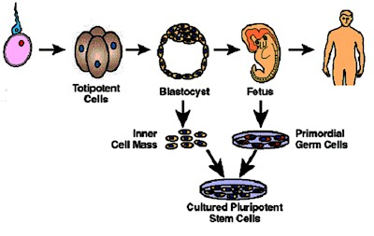

Slide 19
Is Stem Cell Research Ethical?
Embryonic Stem Cells - always morally objectionable, because the human embryo must be destroyed in order to harvest its stem cells.
Embryonic Germ Cells - morally objectionable when utilizing fetal tissue derived from elective abortions, but morally acceptable when utilizing material from spontaneous abortions (miscarriages) if the parents give informed consent.
Umbilical Cord Stem Cells - morally acceptable, since the umbilical cord is no longer required once the delivery has been completed.
Placentally-Derived Stem Cells - morally acceptable, since the afterbirth is no longer required after the delivery has been completed.
Adult Stem Cells - morally acceptable.

Slide 20
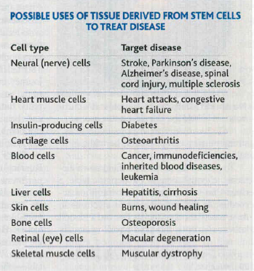

Slide 21
Challenges to Stem Cell/Cloning Research
Stem cells need to be differentiated to the appropriate cell type(s) before they can be used clinically.
Recently, abnormalities in chromosome number and structure were found in three human ESC lines.
Contamination by viruses, bacteria, fungi, and Mycoplasma possible.
The use of mouse “feeder” cells to grow ESC could result in problems due to
xenotransplantation (complicating FDA requirements for clinical use).
Stem cell development or proliferation must be controlled once placed into patients.
Possibility of rejection of stem cell transplants as foreign tissues is very high
Notes:
Like all immortal cell lines, embryonic stem cell lines must be protected and checked for contamination with viruses, bacteria, fungi, and Mycoplasma. The use of infected lines in patient treatment could have devastating effects. Many embryonic stem cell lines are grown using mouse feeder cells. The mouse cells help the embryonic lines to grow, but pose risks for transplantation due to compatibility problems in human bodies.¹
Reference
Kennedy, Donald. 2003. Stem Cells: Still Here, Still Waiting. Science 300: 865.

Slide 22
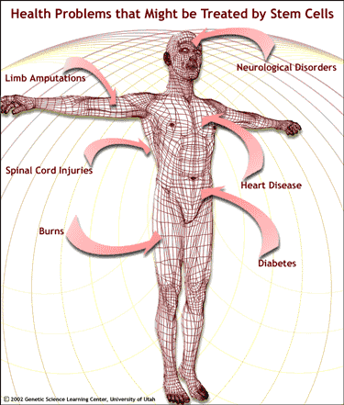
APPLICATIONS
Disease
Diabetes, Spinal cord injury, Parkinson’s disease, heart disease
Genetic based Disease
Cystic fibrosis, Huntington’s

